Slide 1


#XamarinDevDays

Slide 2
Cross-Platform Native User Interfaces with Xamarin.Forms
Presenter Name
Presenter Twitter
Presenter Title

Slide 3
Meet Xamarin.Forms
Build native UIs for iOS, Android, and Windows
from a single, shared C# codebase.

Slide 4
Xamarin + Xamarin.Forms
iOS C# UI
Android C# UI
Windows C# UI
Shared UI Code
Shared C# Backend
Shared C# Backend
Traditional Xamarin Approach
With Xamarin.Forms: More code-sharing, all native

Slide 5
What’s included
✓ 40+ Pages, layouts, and controls
(Build from code behind or XAML)
✓ Two-way data binding
✓ Navigation
✓ Animation API
✓ Dependency Service
✓ Messaging Center
Shared UI Code
Shared C# Backend

Slide 6
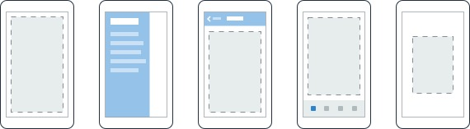
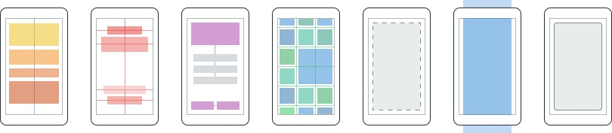
Layouts
Pages
Content
MasterDetail
Navigation
Tabbed
Carousel
Stack
Absolute
Relative
Grid
ContentView
ScrollView
Frame
Notes:
Inside of a page are layouts
A lot of options from something simple like a stack panel to complex and powerful grids

Slide 7
Controls
ActivityIndicator
BoxView
Button
DatePicker
Editor
Entry
Image
Label
ListView
Map
OpenGLView
Picker
ProgressBar
SearchBar
Slider
Stepper
TableView
TimePicker
WebView
EntryCell
ImageCell
SwitchCell
TextCell
ViewCell
Notes:
You have more than 40 controls, layouts, and pages to mix and match from.
These are all of the controls you have out of the box, you can of course create your own.
What is unique is you get the native control and have access to it.
Consider an Entry Field
On iOS it is mapped to UITextField
Android it is EditText
Windows Phoen it is a TextBox

Slide 8


Xamarin.Forms Ecosystem

Slide 9
Control Comparison
Windows | Xamarin.Forms
StackPanel | StackLayout
TextBox | Entry
ListBox | ListView
CheckBox | Switch
ProgressBar | ActivityIndicator
Grid | Grid
Label | Label
Button | Button
Image | Image
Date/TimePicker | Date/TimePicker

Slide 10
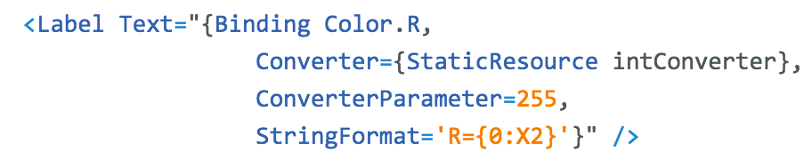
Windows | Xamarin.Forms
DataContext | BindingContext
{Binding Property} | {Binding Property}
ItemsSource | ItemsSource
ItemTemplate | ItemTemplate
DataTemplate | DataTemplate
Binding
Comparison

Slide 11
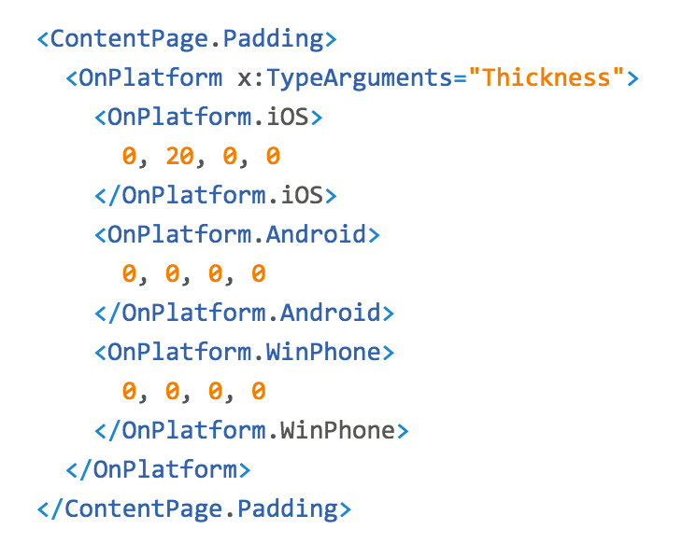
Platform
Customization

Slide 12
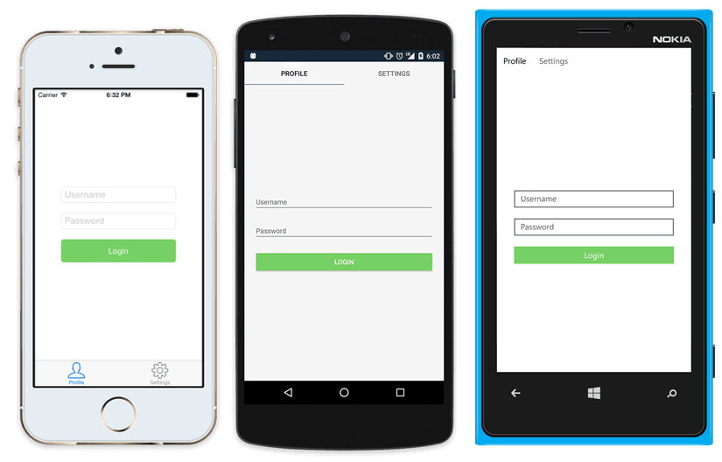
Native UI from shared code
<?xml version="1.0" encoding="UTF-8"?>
<TabbedPage xmlns="http://xamarin.com/schemas/2014/forms"
xmlns:x="http://schemas.microsoft.com/winfx/2009/xaml"
x:Class="MyApp.MainPage">
<TabbedPage.Children>
<ContentPage Title="Profile" Icon="Profile.png">
<StackLayout Spacing="20" Padding="20"
VerticalOptions="Center">
<Entry Placeholder="Username"
Text="{Binding Username}"/>
<Entry Placeholder="Password"
Text="{Binding Password}"
IsPassword="true"/>
<Button Text="Login" TextColor="White"
BackgroundColor="#77D065"
Command="{Binding LoginCommand}"/>
</StackLayout>
</ContentPage>
<ContentPage Title="Settings" Icon="Settings.png">
<!-- Settings -->
</ContentPage>
</TabbedPage.Children>
</TabbedPage>

Slide 13
Xamarin.Forms Demo

Slide 14
What’s new? Xamarin.Forms 2.0!

Slide 15
Xamarin.Forms is Open Source!
open.xamarin.com
Notes:
Apple has a developer preview where Xamarin has alphas ready. Google does not offer this.
Android versions are usually 4 to 8 weeks out for a stable release, but alphas and betas are usually earlier.
Xamarin realizes how important having iOS ready because within 24 hours a large portion of iOS users upgrade
Android on the other hand is much different. After 4 months on the market Android 4.4 only had 1% adoption

Slide 16
Performance Performance Performance

Slide 17
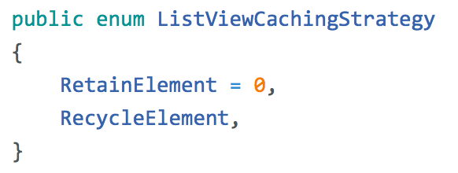
ListView CachingStrategy
✓ Improves scrolling performance
✓ Old behavior is currently the default (but likely to change)

Slide 18
XAML Compilation
XAML
XAMLC
Compile-time
Parsed & turned into IL
Runtime
Parsed and inflated

Slide 19
Benefits
✓ Faster Loading
✓ Smaller App Size
✓ See XAML errors at build time

Slide 20
Design & Controls

Slide 21
Data Templates

Slide 22
CarouselView
Embeddable Carousel
ItemTemplate & DataTemplates
Highly customizable & Virtualized

Slide 23
Effects I
✓ Custom renderer “lite”
✓ Change properties on the native control
✓ Optional
✓ “stringly-typed”
X No methods or events
X No replacing the control
Notes:
A unique aspect of Xamarin.Forms is an abstraction over the user interface, but what about the platform specific functionality that makes these devices so special?
That is where plugins for Xamarin come in.

Slide 24
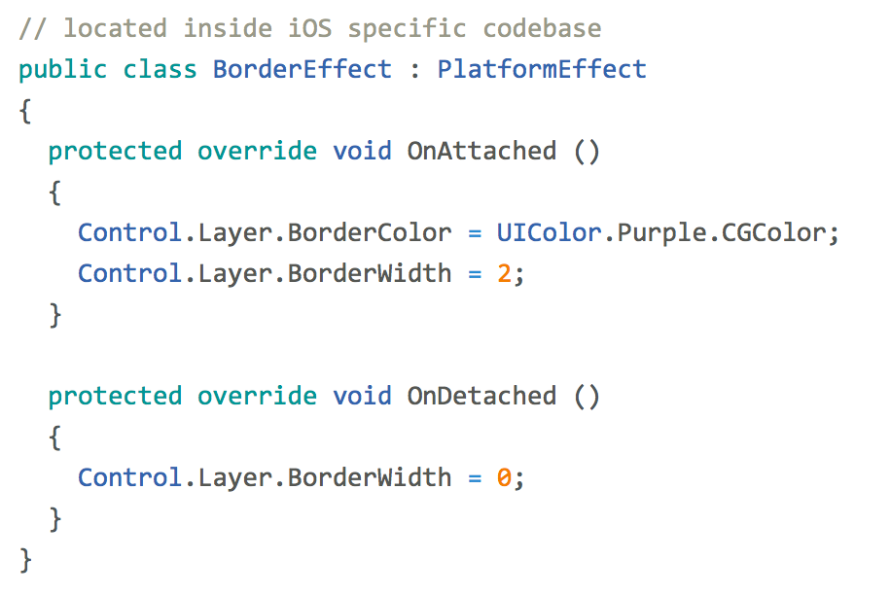
Effects II
entry.Effects.Add (Effect.Resolve("Xamarin.BorderEffect"));
Notes:
A unique aspect of Xamarin.Forms is an abstraction over the user interface, but what about the platform specific functionality that makes these devices so special?
That is where plugins for Xamarin come in.

Slide 25
So much more

Slide 26
XAML Previewer

Slide 27
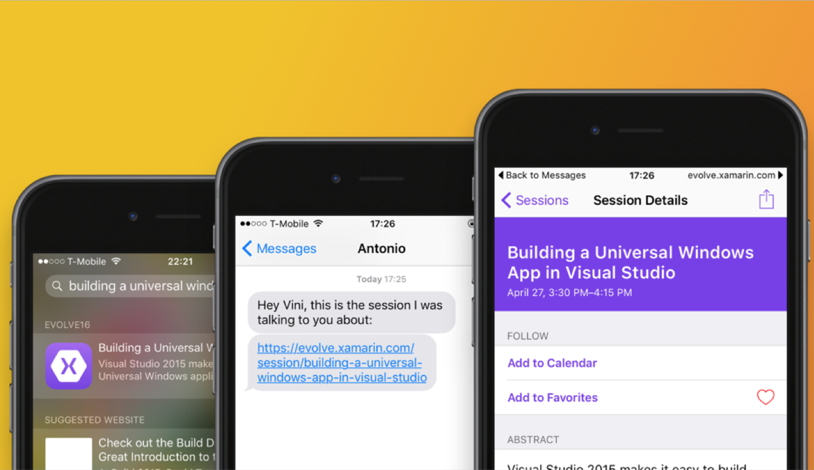
URL Navigation
Notes:
Connect Web to Mobile
Simple cross platform API over:
CoreSpotlight
NSUserActivity
Google App Indexing

Slide 28
DataPages
https://developer.xamarin.com/guides/xamarin-forms/datapages/

Slide 29
Themes
https://developer.xamarin.com/guides/xamarin-forms/themes/

Slide 30
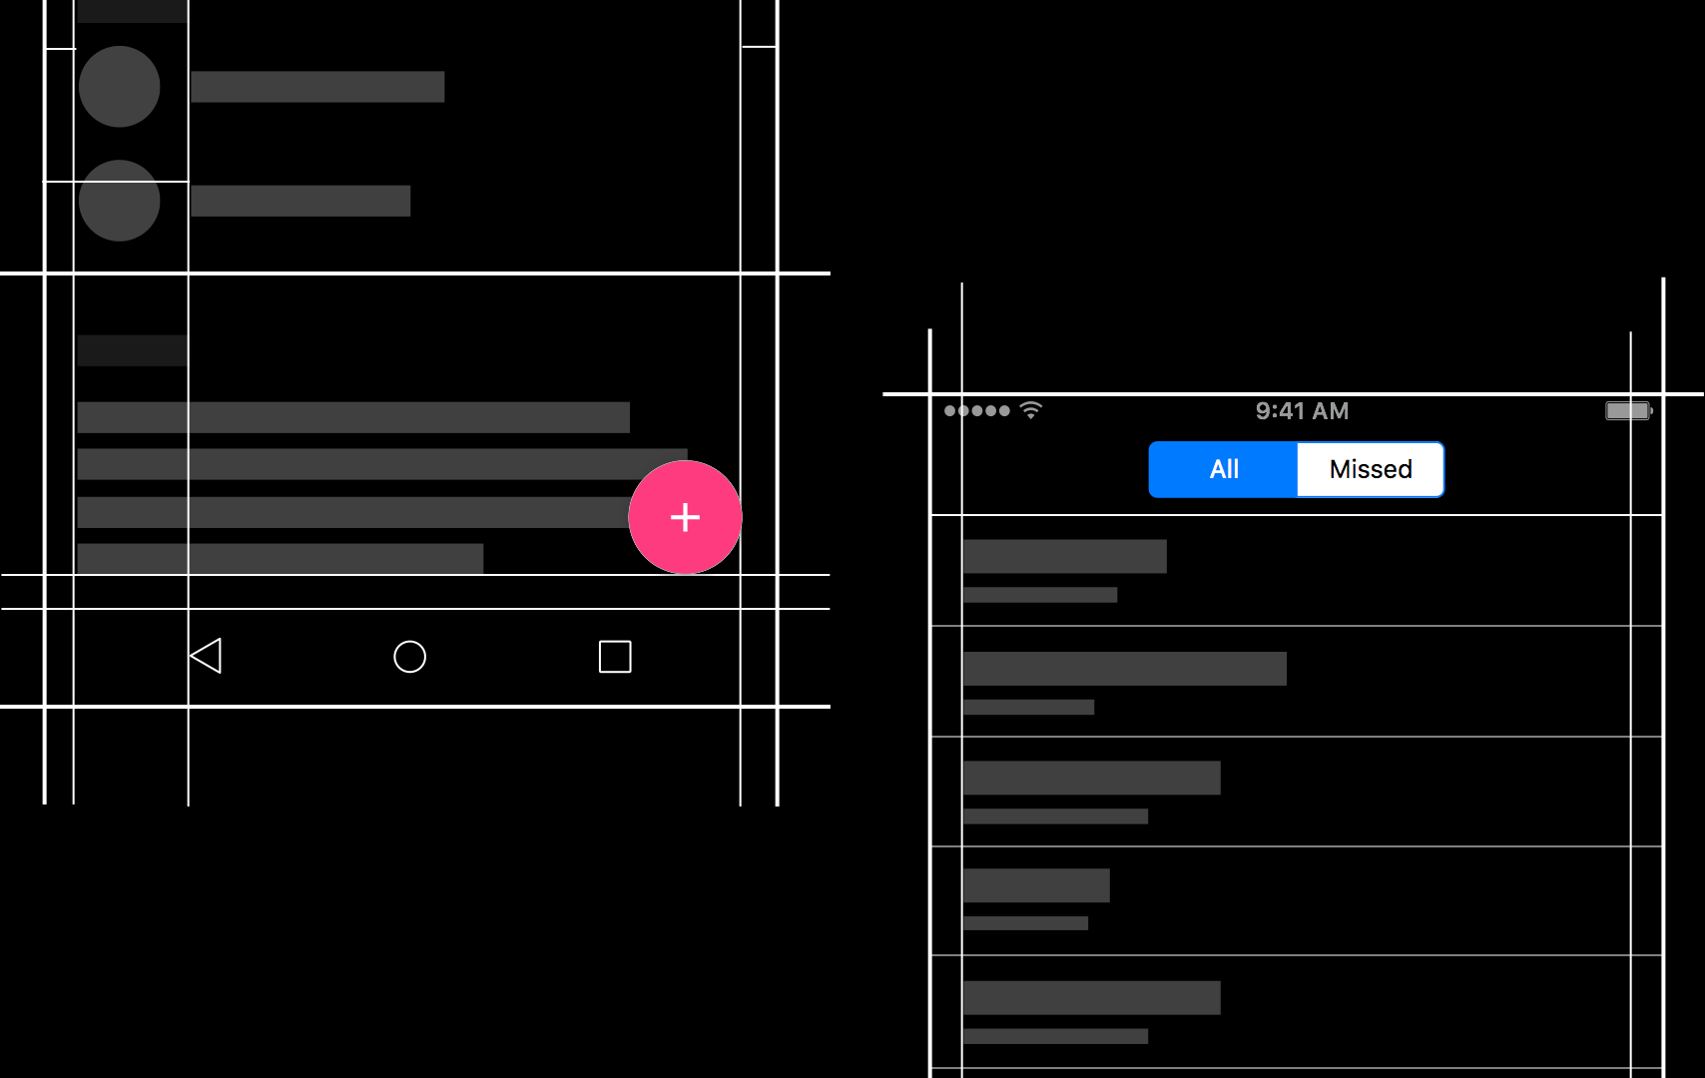
Native Embedding
Notes:
Easily embed any native control into a Xamarin.Forms layout.

Slide 31
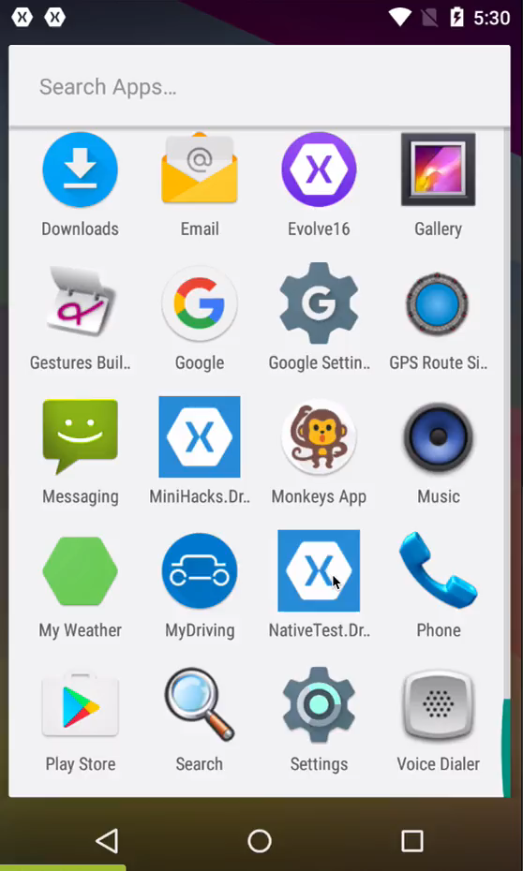
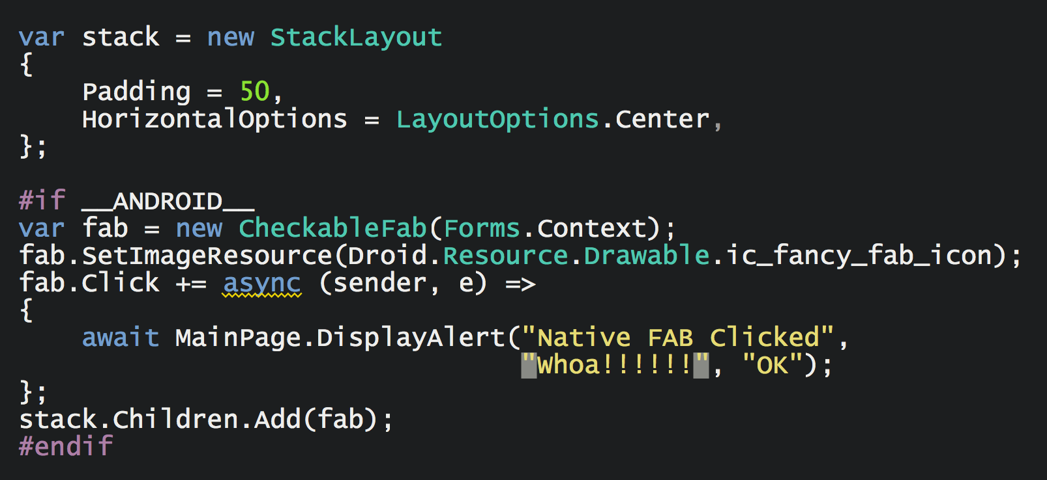
Native Embedding
Notes:
Just add it as child to a layout.
Exposed as an Extension Method.

Slide 32
20 Minute Break
Presenter First Name
Presenter Last Name
Presenter Title
Presenter e-mail
blogs
Twitter

